Slide 1
How to generate BitFile
Modulator: Jay Gao

Slide 2
Outline
Generate BitFile
Vivado set up
FPGA pin assignment
Output bitfile to NAS
Memory map file
Summary
Notes:
結論:不希望B domain 在sample時 A domain的data正在變化

Slide 3
Generate BitFile
Vivado set up
FPGA pin assignment
Output bitfile to NAS
/tmp_data/jay/projects/venusV12_forDante_fpga/vivado

Slide 4
Vivado set up
.tcl file (run_chip_top.tcl)
Set file output direction
Set up FGPA’s IC chip name
Read verilog
Read ip (clk, sram…) (.xci)
Read .xdc (set_up property, clock, port…) (top_full.xdc)
run synthesis (report utilization and timing estimates, write checkpoint design)
run placement and logic optimzation, report utilization and timing estimates, write checkpoint design
run router (report actual utilization and timing, write checkpoint design). run drc, write verilog and xdc out
generate a bitstream
In .xdc file (top_full.xdc), need:
Generate clock, set protperty…
Set up FPGA pin (it must be sure, or FPGA will be broken)
Set asynchronous group (affect routing time very much)

Slide 5
FPGA pin assignment
Choose pin from: Z:\PROJECT\FPGA_KC705_daughterboard/FPGA_DB_PHY Board Pin list.xlsx
Reference:
Z:\Doc\FPGA\ug810_KC705_Eval_Bd.pdf
Z:\Doc\FPGA\kc705_Schematic_xtp132_rev1_1.pdf
Z:\Doc\FPGA\FPGA_KC705_DB_V1.0.0.pdf
Note:
Clock pin must choose xxxCC_P.
LVCMOS has more noise margin than TTL.
To reduce electromagnetic radiation while increasing switching speed: LVDS.
Watch out whether pin is support with function of Level shift (hardware side testing) (FPGA output is 2.5V, Raspberry Pi output is 3.3V)!!
SOME high performance pin can not be assign. Ex: HPC_DPx_C2M

Slide 6
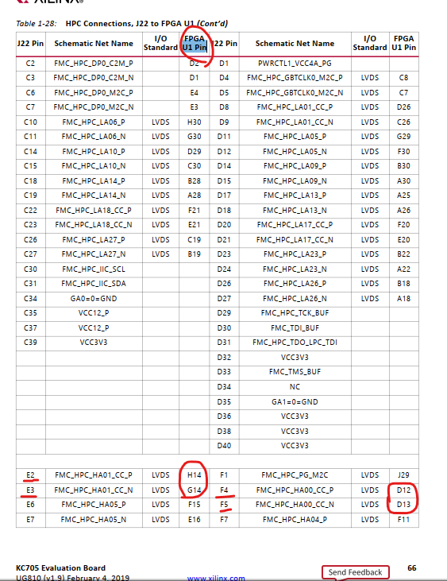
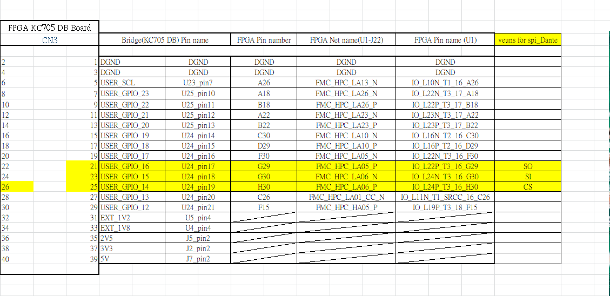
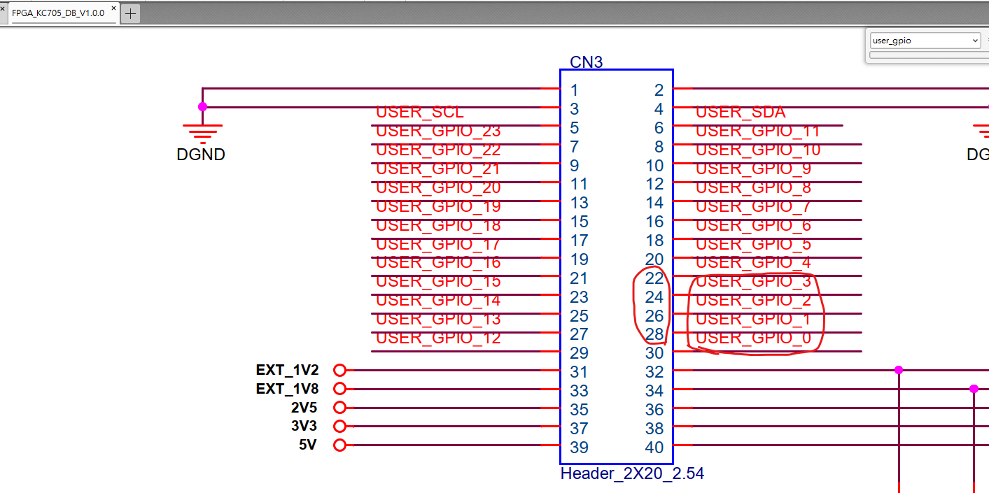

Slide 7
Output bitfile to NAS
Copy bit file to: home/wallace/Downloads/bitfile/jay/xxxx
Please ask Wallace for downloading file to NAS/TEMP/to_Jay/xxx

Slide 8
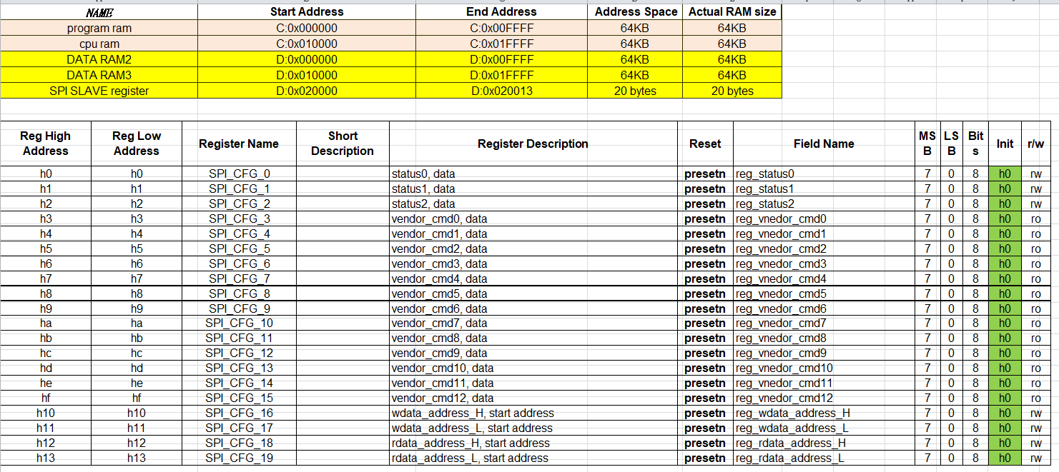
Memory Map
Z:\PROJECT\Venus(SD3.0 Card)\03_Registers\01_Top\spi_slave

Slide 9
Summary

Slide 10
Summary
RTL design (can use spyglass to check)
Design Patterns (as many as cases)
Check Synthesizable (use DC compiler)
Generate BitFile
Give FW/SW below documents:
BitFile
FPGA Pin information
Memory map information
Ask FW to access RAM and regif with cpu (confirm bitfile is programed into FPGA)

Slide 11
Reference

Slide 12
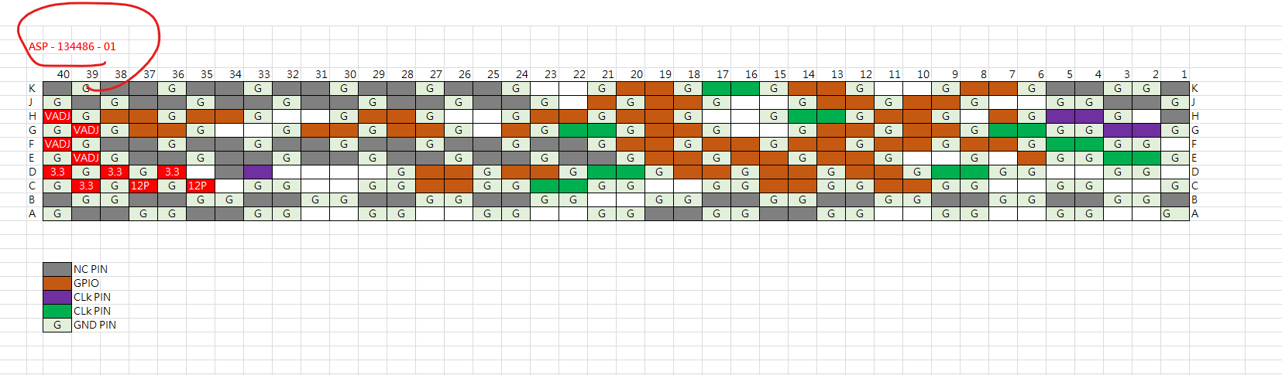
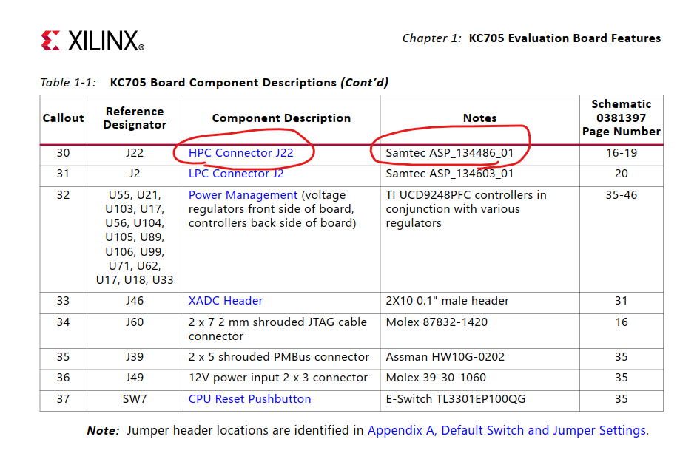
ASP - 134486 – 01
HPC
Z:\Doc\FPGA\ FPGA_KC705_DB_190929.xls

Slide 13
有跨domain的話要加上
set_clock_group -name async_spito25 -asynchronous -group {clk_spi_60} -group {clk_25}
set_clock_group -name async_spito60 -asynchronous -group {clk_60} -group {clk_spi_60}
set_false_path-from [get_clocks CLKA] -to [get_clocks CLKB]].
只能指定单方向路径的timing exceptions。如果需要指定双向的timing exceptions，则需要
set_false_path -from [get_clocks CLKA]-to [get_clocks CLKB]]
set_false_path -from [get_clocks CLKB]-to [get_clocks CLKA]]
set_clock_groups –asynchronous –name my_ASYNC -group {CLKA CLKA_div2} -group {CLK_OSC}
工具不会分析CLKA 和CLK_OSC、CLKA_div2 和 CLK_OSC之间的时序，但是会分析他们之间的Crosstalk。
https://zhuanlan.zhihu.com/p/89817877

Slide 14
Tcl的註解 # 不能放在行尾，tool會認成 syntex error
FGPA option選擇
https://codeantenna.com/a/d1HqmGTmH5
https://docs.xilinx.com/r/en-US/ug904-vivado-implementation/Directives-Used-by-phys_opt_design-and-route_design-in-Implementation-Strategies

Slide 15
FGPA pin 類別
https://xilinx.eetrend.com/blog/2022/100562240.html
https://xilinx.eetrend.com/d6-xilinx/blog/2011-06/1905.html
https://docs.xilinx.com/r/en-US/ug583-ultrascale-pcb-design/Overview?tocId=5RSoJqU2wHCQGWn8cg5FFQ

Slide 16
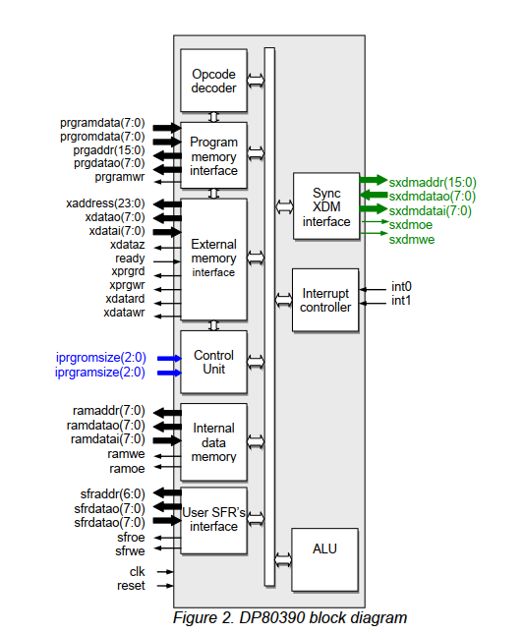
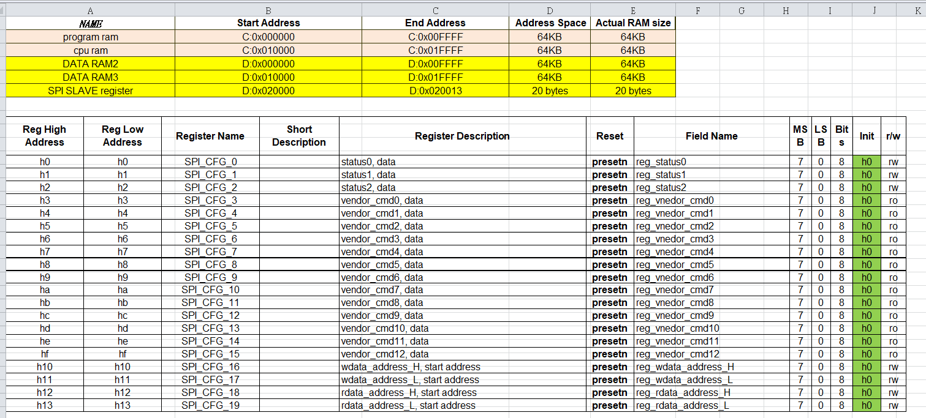

Slide 17
Debug pin
若有synthesis 完後的dcp檔
可以直接吃dcp檔再吃ila.xdc，可以省去synthesis的時間
要在rtl裡面新增(* syn_keep = “true”, mark_debug = “true” *)，wire/reg/input/output都可以

Slide 18
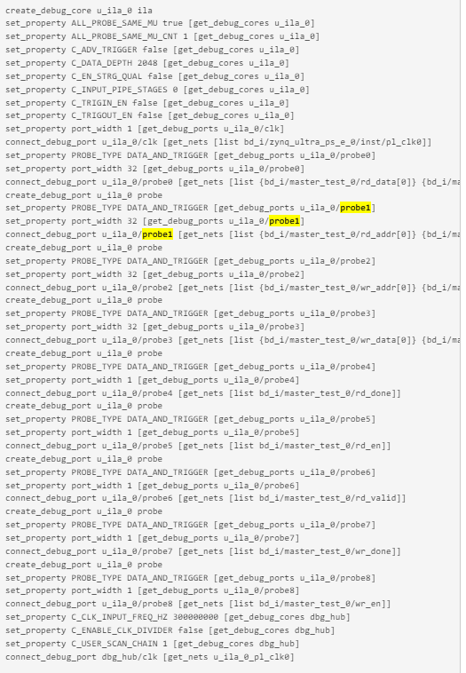
Debug pin
https://support.xilinx.com/s/article/1004299?language=zh_CN
create_debug_port u_ila_0 probe
set_property PROBE_TYPE DATA_AND_TRIGGER [get_debug_ports u_ila_0/probe8]
set_property port_width 4 [get_debug_ports u_ila_0/probe8]
connect_debug_port u_ila_0/probe8 [get_nets [list {iV0_top/uSM2703_CORE/uSDH/p_i_sdat[0]} {iV0_top/uSM2703_CORE/uSDH/p_i_sdat[1]} {iV0_top/uSM2703_CORE/uSDH/p_i_sdat[2]} {iV0_top/uSM2703_CORE/uSDH/p_i_sdat[3]} ]]
注意每個{}一定要空格!!
注意probe一定要照順序
(* syn_keep = “true”, mark_debug = “true” *)不能在同一根pin但不同reg/wire上重複加，會秀probe0 error,

Slide 19
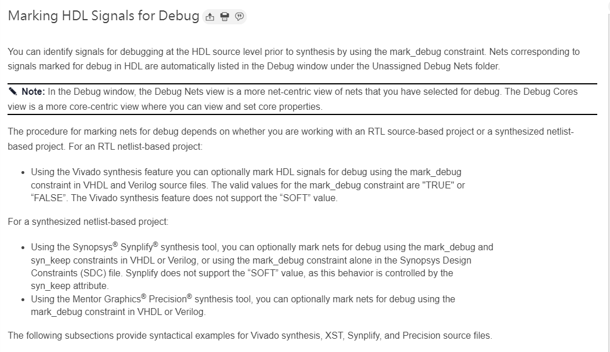
Debug pin
https://docs.xilinx.com/r/en-US/ug908-vivado-programming-debugging/Marking-HDL-Signals-for-Debug
Ila core 跟 debug hub 關係: https://bbs.elecfans.com/m/jishu_1671582_1_1.html
Ial core的clock設定: https://hackmd.io/@eng-lyon/ByJEolFr9

Slide 20
FPGA中可执行文件：bit/bin/mcs/elf
https://xilinx.eetrend.com/blog/2021/100112660.html

Slide 21
持續等待之log-大約都要超過2hr解決方法
situation
Phase 6.2 Additional Hold Fix
lut route thru assignment for hold
solution
check clk (async group? ….)

